Slide 1
Integrated Circuit Processing
Pulling ingots
Wafers
Patterning
Fabrication cycle
Testing
Packaging
CAD design of ICs
Future issues

Slide 2
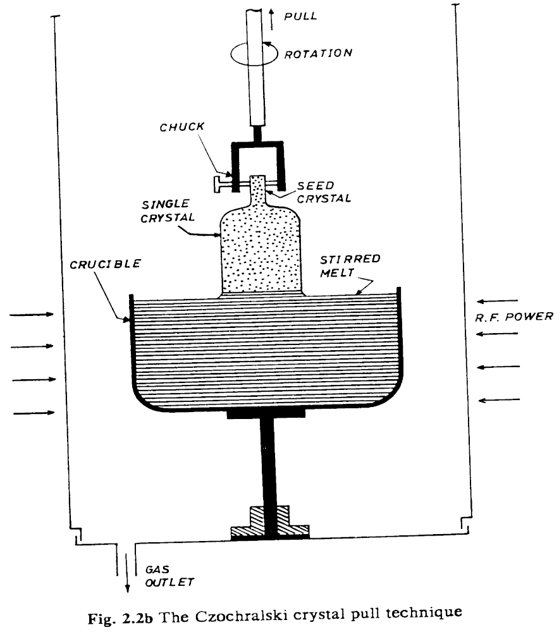
Pulling Ingots
Monocrystalline silicon is produced from purified polycrystalline silicon by “pulling” an ingot
  polysilicon is melted using radio frequency induction heaters
  “seed crystal” of monocrystalline silicon is dipped into melt
  silicon grows around structure of seed as seed is slowly withdrawn

Slide 3
Pulling Ingots (continued)
Produces an ingot of pure silicon
  400 mm - 1000 mm long (15” - 39”)
  150 mm - 200 mm in diameter (6” - 8”)
Growth is a slow process
  10 - 20 hours
Silicon is often doped as it’s grown

Slide 4
Wafers
Ingot is finely shaped using abrasive belts
  flat spot added for alignment during processing
Sawed into wafers about 600 microns thick
  only a few microns are actually used for IC devices
  then etched, polished, and cleaned
  stacked in carriers

Slide 5
Silicon Dioxide and Polysilicon
Silicon dioxide is created by interaction between silicon and oxygen or water vapor
  Si + O₂ = SiO₂ or Si + 2H₂O = SiO₂ + 2H₂
  protects surface from contaminants
  forms insulating layer between conductors
  form barrier to dopants during diffusion or ion implantation
  grows above and into silicon surface
Polysilicon
  silicon without a single crystal structure
  created when silicon is epitaxially grown on SiO₂
  also a conductor, but with much more resistance than metal or diffused layers
  commonly used (heavily doped) for gate connections in most MOS processes
40%
60%

Slide 6
Patterning
Patterning creates a regular pattern on the surface of the chip, which is used to create features of the IC
  involves alternative lithography and etching steps
  each of several layers involves a separate pattern
Lithography
  patterns are contained on masks
    eg, chrome on glass
  surface of the wafer is covered with photoresist
    organic material sensistive to uv light or X-rays
    spin and bake
    positive resist becomes more soluable when exposed
      resist will be removed where mask is clear
    negative resist becomes less soluable when exposed
      resist will be removed where mask is opaque

Slide 7
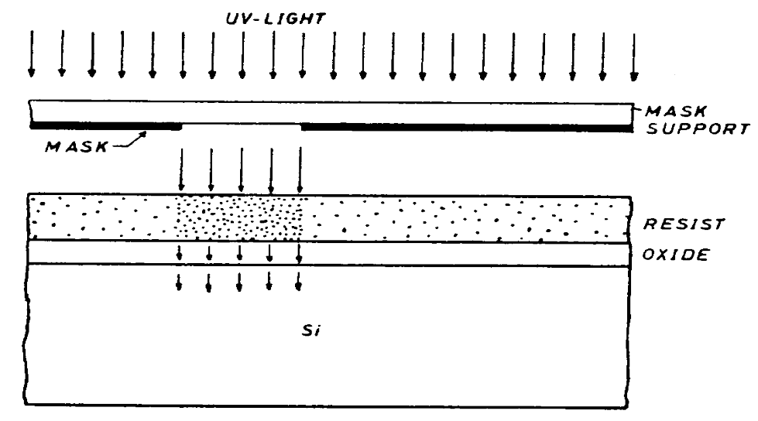
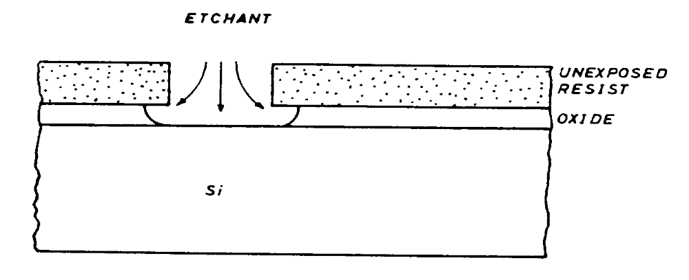
Patterning (continued)
Lithography (continued)
  mask placed very close to wafer, flooded with uv light
  solvents remove exposed (unexposed) resist
Etching removes material from wafer surface where resist has been removed
  isotropic etching works at same rate in all directions of material

Slide 8
Patterning (continued)
Etching (continued)
  anisotropic etching works faster in one direction than the other
  wet etching uses liquid solvents to remove materials
    eg, HF for SiO₂
  dry etching uses gas to remove materials
    less undercutting
    can monitor reactants during process, determine automatically when etching is finished
Finally, remaining photoresist is removed
  organic solvents or chromic acid
  pure oxygen, to oxidize organic resist materials

Slide 9
Metalization
Metalization is used to create contacts with the silicon and to make interconnections on the chip
Desired properties are
  low resistivity
    in ohms/square
  good adhesion to silicon and insulators
  good coverage of steps in chip surface
  immunity to corrosion
  ductility (so temperature cycles don’t cause failures)

Slide 10
Metalization (continued)
Aluminum is common choice but
  Al causes spikes into Si, giving leaky junctions
  high currents carry Al atoms with them, creating shorts
  low melting point prohibits high heat processing later
Latest step is to use copper
  IBM has been shipping chips with copper for a year
    smaller, 50% less power consumption
  other fabs to follow soon

Slide 11
NMOS Fabrication Cycle
Start with p-type silicon wafer
Grow a “passivation” layer of SiO₂ (silicon dioxide) over the entire wafer
Use lithography and a mask to define the source and drain areas, and etch to expose the wafer surface
  first masking step
Diffuse phosphorous to create source and drain n-type regions

Slide 12
NMOS Fabrication Cycle (continued)
Use lithography and a mask to define the gate area, and etch to expose the wafer surface
  second masking step
Grow a thin layer of SiO2 as the gate insulator
Use lithography and a mask to define the source and drain contact areas, and etch to expose the wafer surface
  third masking step

Slide 13
NMOS Fabrication Cycle (continued)
Evaporate metal (typically copper) over entire surface of wafer
Use lithography and a mask to define the interconnect areas, and etch away all other metal
  fourth masking step
An excellent animation of this process is available at
http://jas.eng.buffalo.edu/applets/
education/fab/NMOS/nmos.html

Slide 14
Testing
Two different kinds of testing
  process testing
  function testing
Process testing uses special patterns in separate areas on the wafer to measure important parameters
  resistivity of various conductive materials
    diffused or ion implanted areas
    polysilicon
    metal
  contact resistance
  line width and mask alignment
  simple components
    transistors
    capacitors
    simple logic gates

Slide 15
Testing (continued)
Functional testing
  simple or regular circuits can be tested completely
    memories
  complex circuits cannot be fully tested
    test individual functions or paths
      registers
      arithmetic and logic units
      simple instructions
      data paths
  modifying designs for easier testing, and automated visual inspection for particular flaws, are active research areas

Slide 16
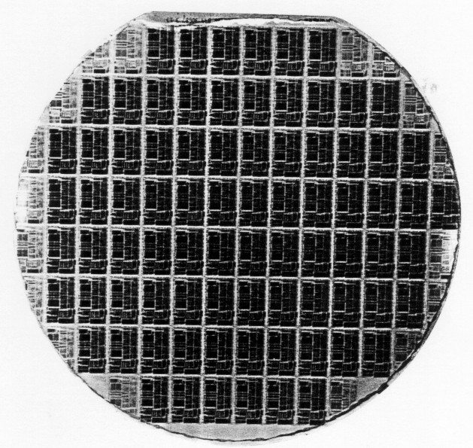
Packaging
Silicon processing steps are performed on whole wafers
  150mm to 200mm in diameter

Slide 17
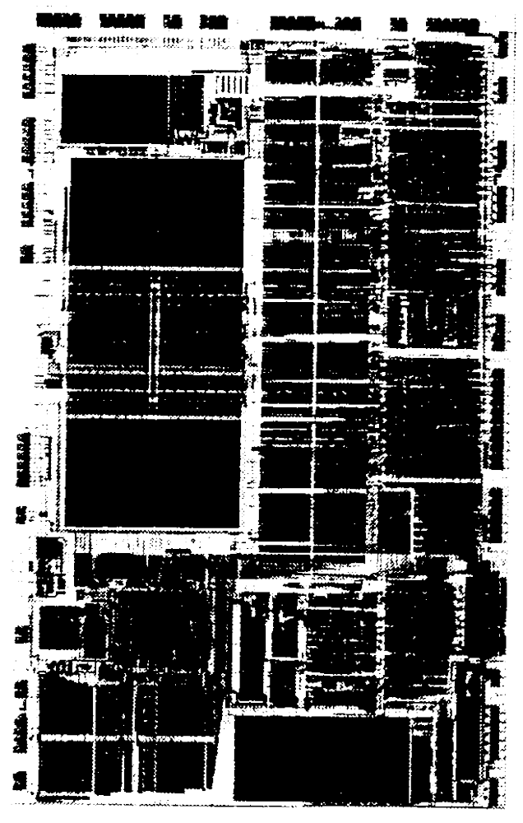
Packaging (continued)
Each wafer contains many individual chips
  5mm to 15 mm square
Chips are scribed with a diamond saw or diamond-tipped scribe, or a laser, and fractured along the scribe lines into chips

Slide 18
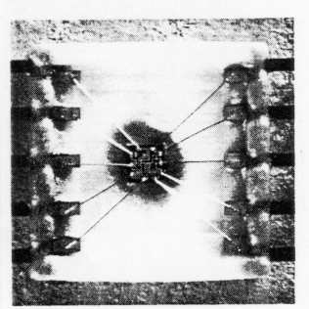
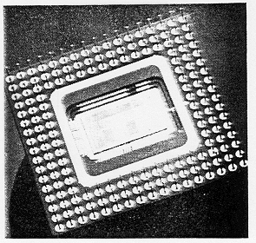
Packaging (continued)
Each chip is cemented into a package
Wire leads from pins on the package to bonding pads on the chip are installed
A cover is cemented over the cavity and marked

Slide 19
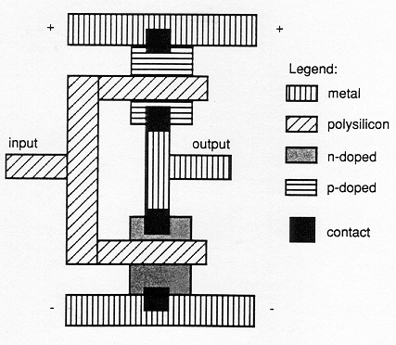
Computer-Aided Design of ICs
IC design started as hand process
  leads to many errors
  requires many trial fabrications and tests to refine design before production
    small batches, very expensive
Around 1980, computer-aided design systems began to be used for ICs
  simple notations for expressing components of chip
  component libraries for reuse of earlier designs
    and mirroring, rotation, etc.

Slide 20
Computer-Aided Design of ICs (continued)
CAD systems (continued)
  enforce design rules
  help with routing of connections
  simulation of interim designs
    2-D or 3-D device simulators
    logic simulators
    timing simulators
Design and layout happens at display
Simulation happens in batch mode
  extremely computation intensive
Once design is ready for fabrication, CAD system produces pattern generation files

Slide 21
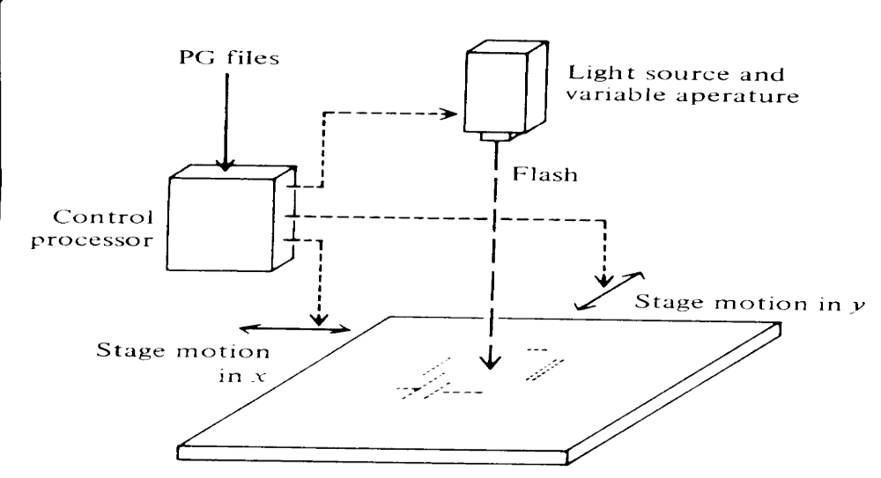
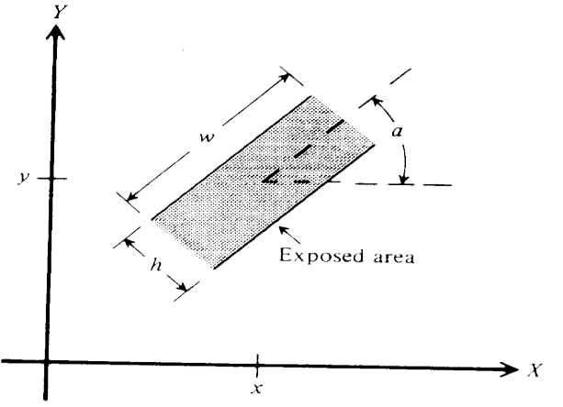
Computer-Aided Design of ICs (continued)
PG files go to mask house to create masks
  photographic exposure of geometric patterns to produce mask pattern (reticle) for one IC
    typically 10x or more final size

Slide 22
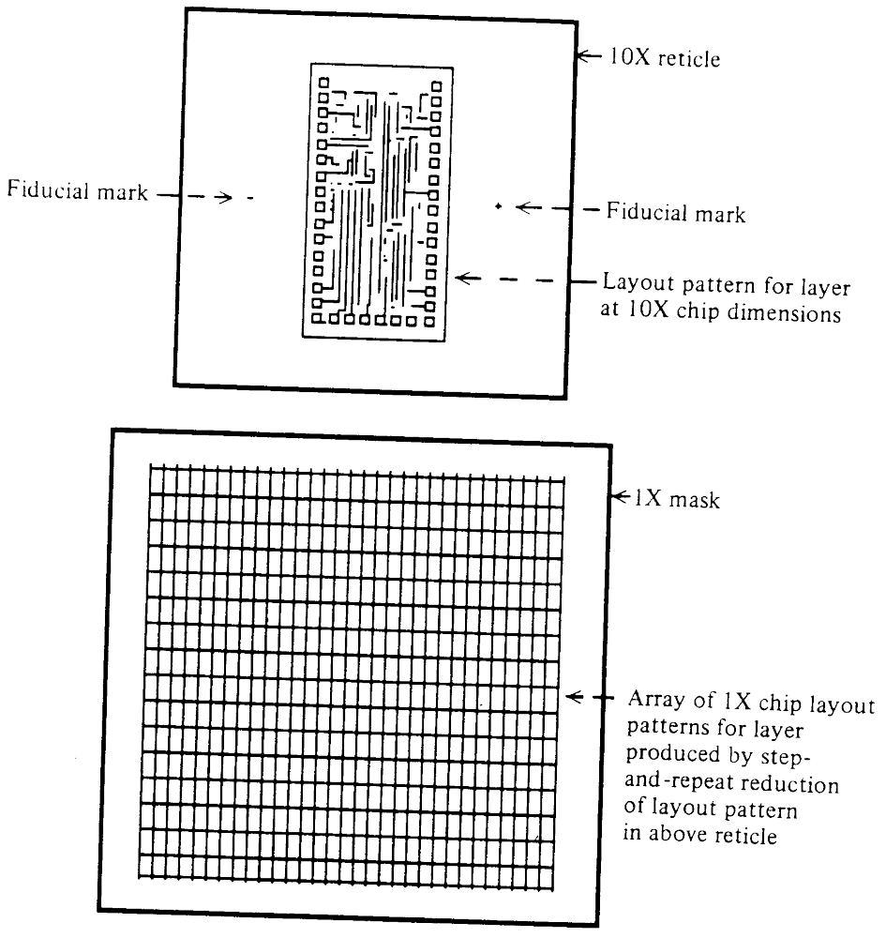
Computer-Aided Design of ICs (continued)
  photo enlarge to produce “blowbacks” for visual inspection
  create mask master by “step and repeat” photo reduction of reticle
    precise alignment essential
  make submaster and working masks
Send masks to fab line and fabricate wafers

Slide 23
IC Design Rules
Want design of IC to be independent of process used to implement design
  especially want to scale as process technologies improve
Place constraints on widths, separations, overlaps
  base all measures on elementary distance unit λ
  each process defines a value for λ in microns
  pattern generator produces output files appropriately
Examples
  diffused regions >= 2 λ
  minimum line width 2 λ
  separation of lines >= λ
  gate overlap >= λ
Current processes have λ = 0.18 - 0.25 microns

Slide 24
Future Issues
Current state-of-the-art
  0.18 micron feature size
  die size about 2.5 cm²
  about 5.5 million transistors on logic devices
  64 Mbit DRAMS
    64 million transistors
Lithography
  wavelength of visible light is about 0.5 microns
    less than this difficult to pattern with visible light
    but 0.18 micron process is optical
    uses phase coherence with laser light
  electon beam exposure
    expose resist directly on Si (no mask)
  electron beam reticles, x-ray exposure of wafer
    good for 0.0? micron features
    physical limit of Si

Slide 25
Future Issues (continued)
Die size
  yield goes down as die size goes up
  wafer scale integration
  hampered by warping of wafer since Si and SiO2 expand and contract at different rates
Vertical stacking
Testing
  improved design for testability
  automated visual inspection
Expense management
  partnerships

